Slide 1
CON308
Mastering Kubernetes on AWS
Arun Gupta, @arungupta, AWS
Raffaele Di Fazio, @x0rg, Zalando

Slide 2
Who are we?
Arun Gupta
@arungupta
Principal Open Source Technologist at AWS
Container Geek
Docker Captain
Java Champion
Devoxx4Kids
Minecraft Modder
Author
Runner
Lifelong Learner
Raffaele Di Fazio
@x0rg
Software Engineer at Zalando
Container Orchestration Lover
Gopher
Wine Lover
Runner

Slide 3
Agenda
1
Kubernetes cluster setup
2
CI/CD with applications deployed on Kubernetes
3
AWS Identity and Access Management (IAM)
4
Visibility

Slide 4
1
Kubernetes cluster set-up choices

Slide 5
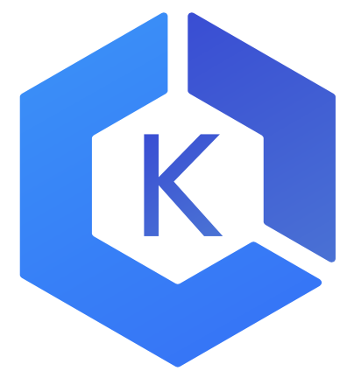
Kubernetes cluster setup
Choices
Install, operate, upgrade, delete a Kubernetes cluster
Development—Minikube
Community—Kops
List: kubernetes-aws.io
Enterprise
Elastic Container Service for Kubernetes (EKS)
CoreOS Tectonic
Red Hat OpenShift*
Custom
CloudFormation
Terraform
AWS Partners: Docker, Heptio, Mesosphere

Slide 6
Manage a Kubernetes cluster
Kops
Community supported
SIG AWS
Kops office hours and Slack channel
Generate CloudFormation or Terraform scripts
github.com/kubernetes/kops
export AWS_AVAILABILITY_ZONES=${ZONES:-"us-east-1b,us-east-1c,us-east-1d"} export KOPS_STATE_STORE="s3://kubernetes-aws-io" kops create cluster cluster.k8s.local \ --master-count 3 \ --master-size m4.large \ --node-count 5 \ --node-size m4.large \ --zones $AWS_AVAILABILITY_ZONES \ --networking calico \ --yes
Notes:
Calico is an open-source plugin that allows for fine-grained network policy enforcement, ensuring that traffic within your Kubernetes cluster can only flow in the direction that you specify. As an example, if we take a scenario where Kubernetes namespaces are used opt enforce boundaries between products, or even enforce boundaries between different environments (e.g. development vs production), network policies can be configured to ensure no unauthorized network traffic is allowed beyond its boundary. Think of it as being similar to applying Security Groups in the AWS world.

Slide 7
Elastic Container Service for Kubernetes
Managed K8s control plane—highly available master and etcd
Bring your own worker nodes, like ECS
Core tenets
Platform for enterprises to run production-grade workloads
Provides a native and upstream Kubernetes experience
Not forced to use additional AWS services, but offer seamless integration
Actively contributes to the Kubernetes project
APIs
aws eks create-cluster \ --cluster-name <> \ --desired-master-version <> \ --role-arn <>

Slide 8



EKS architecture
Master
Master
Master
etcd
etcd
etcd
Availability
Zone 1
Availability
Zone 2
Availability
Zone 3

Slide 9
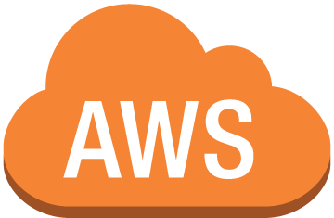
Kubectl
mycluster.eks.amazonaws.com
Availability
Zone 1
Availability
Zone 2
Availability
Zone 3

Slide 10
Cluster setup at Zalando

Slide 11


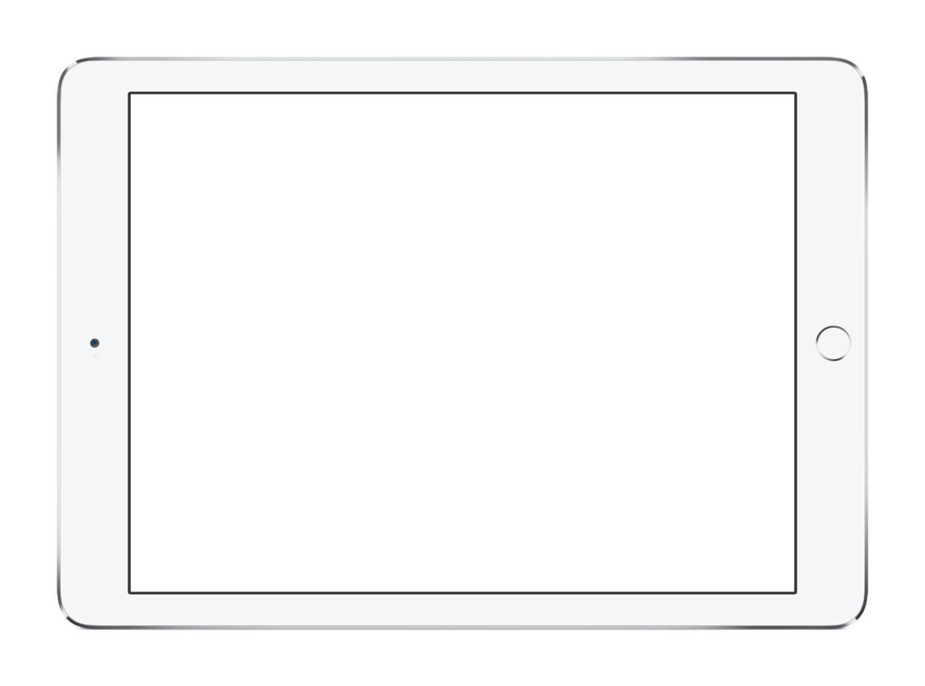
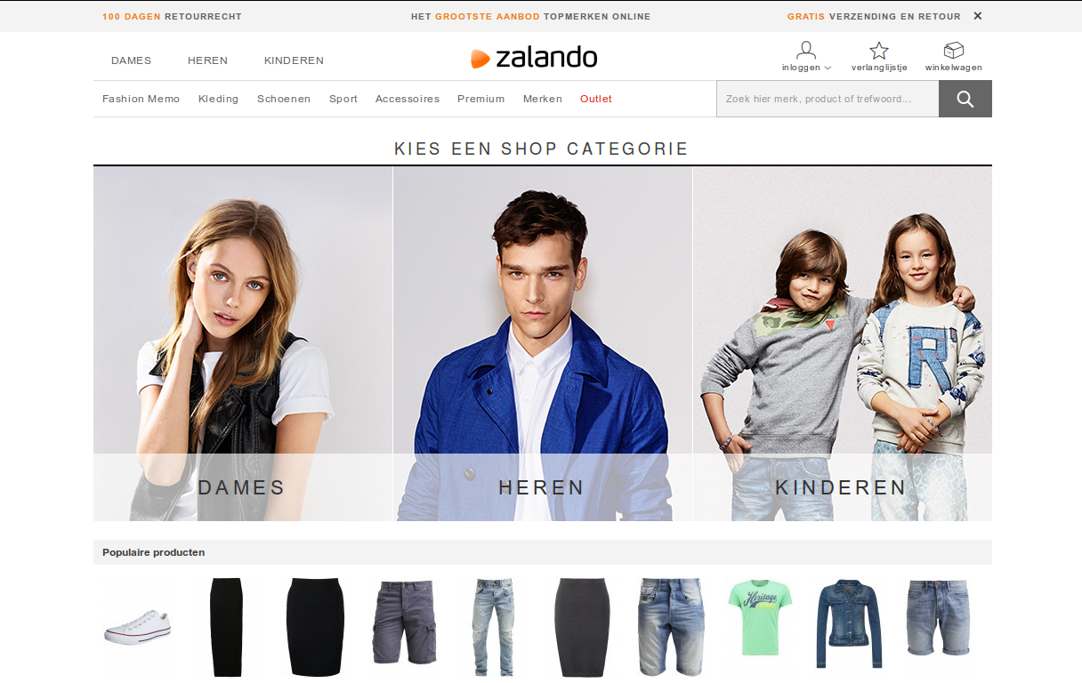
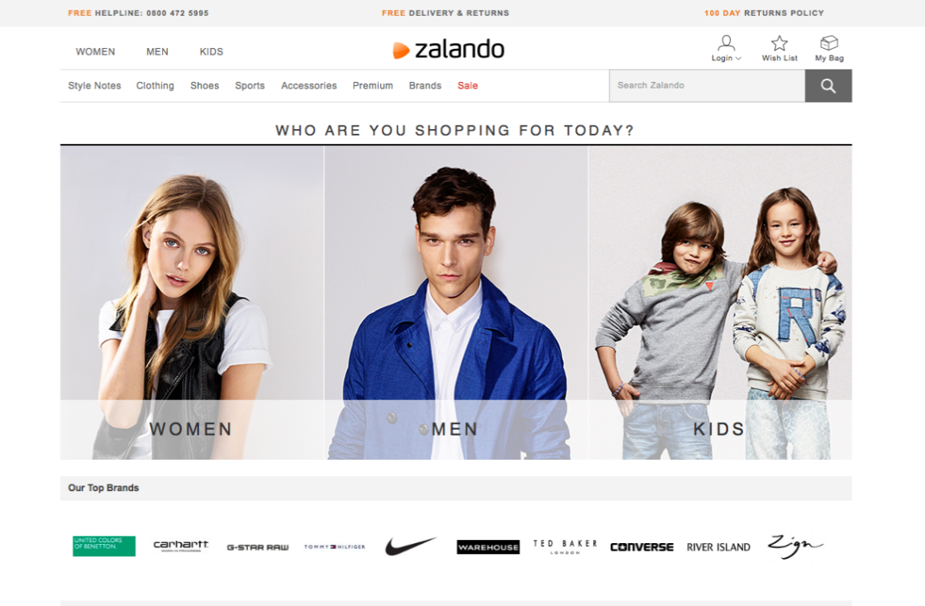
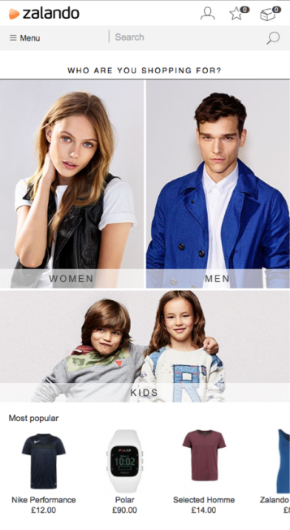
Zalando
Notes:
And here is how our Fashion Store looks like!

Slide 12
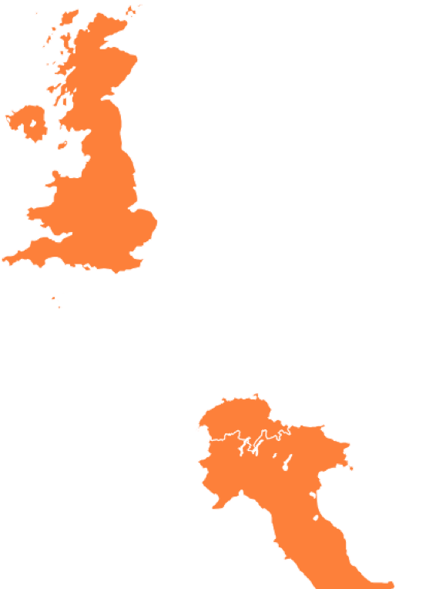



Zalando
15 markets
6 fulfillment centers
22 million active customers
3.6 billion € net sales 2016
200 million visits per month
14,000 employees in Europe
1,900 engineers trained in Tech

Slide 13
Why Kubernetes at Zalando
On-premises
AWS/STUPS
AWS/K8s
Limited capacity
Custom tool
Low density
CloudFormation
High density
Right abstraction

Slide 14
Kubernetes clusters
Multiple AWS accounts—one cluster per account
Currently ~50 Kubernetes clusters
“Small” clusters
Limit impact of possible outages
Kubernetes code not optimized for AWS rate limiting

Slide 15
Setup with CloudFormation
CloudFormation to provision clusters
Why CloudFormation
AWS native
Existing experience and tooling

Slide 16
Base setup
Using Container Linux as OS, no AMI customization
Networking: Flannel to support >50 nodes
Immutable infrastructure
No updates of nodes
Nodes replaced on configuration change

Slide 17


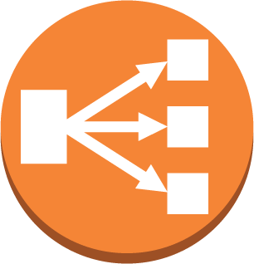
Region
ASG
ASG
AZ
AZ
AZ
Master node
etcd
etcd
AZ
etcd
etcd
Master node
AZ
Cluster setup at Zalando
AZ
etcd
Master node
Auto Scaling Group
Availability Zone
Availability Zone
Worker node
Worker node
Worker node

Slide 18
1. Create
Cluster Registry
RDS
2. Watch
4. Create CF Stack
Cluster operations
Master node
Master node
API Server
API Server
Cluster Lifecycle Manager
5. Apply K8s Manifests
3. Clone
Master node
Master node
Git

Slide 19
2
CI/CD of apps on Kubernetes

Slide 20
CI/CD of apps on Kubernetes
Choices
Jenkins
AWS CodePipeline, AWS CodeCommit, AWS CodeBuild
AWS partners
GitLab
Shippable
CircleCI
Codeship
Notes:
AWS CodeStar enables you to quickly develop, build, and deploy applications on AWS. AWS CodeStar provides a unified user interface, enabling you to easily manage your software development activities in one place. With AWS CodeStar, you can set up your entire continuous delivery toolchain in minutes, allowing you to start releasing code faster.

Slide 21
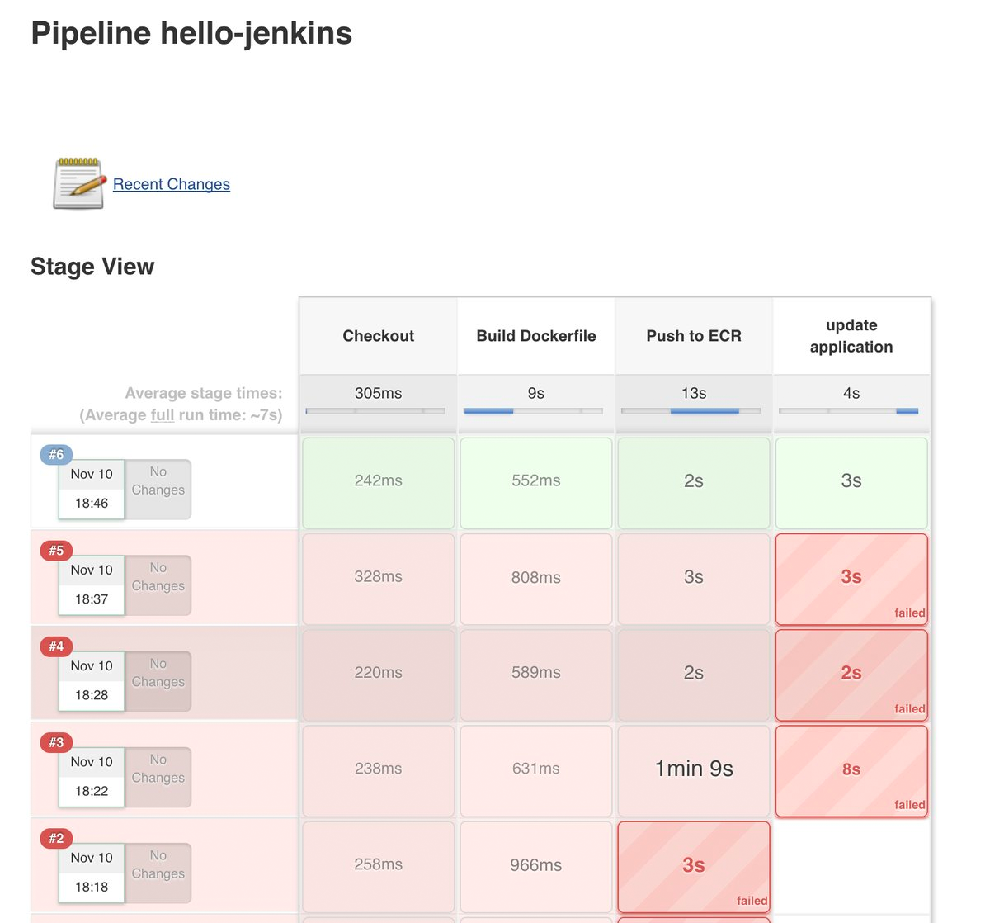
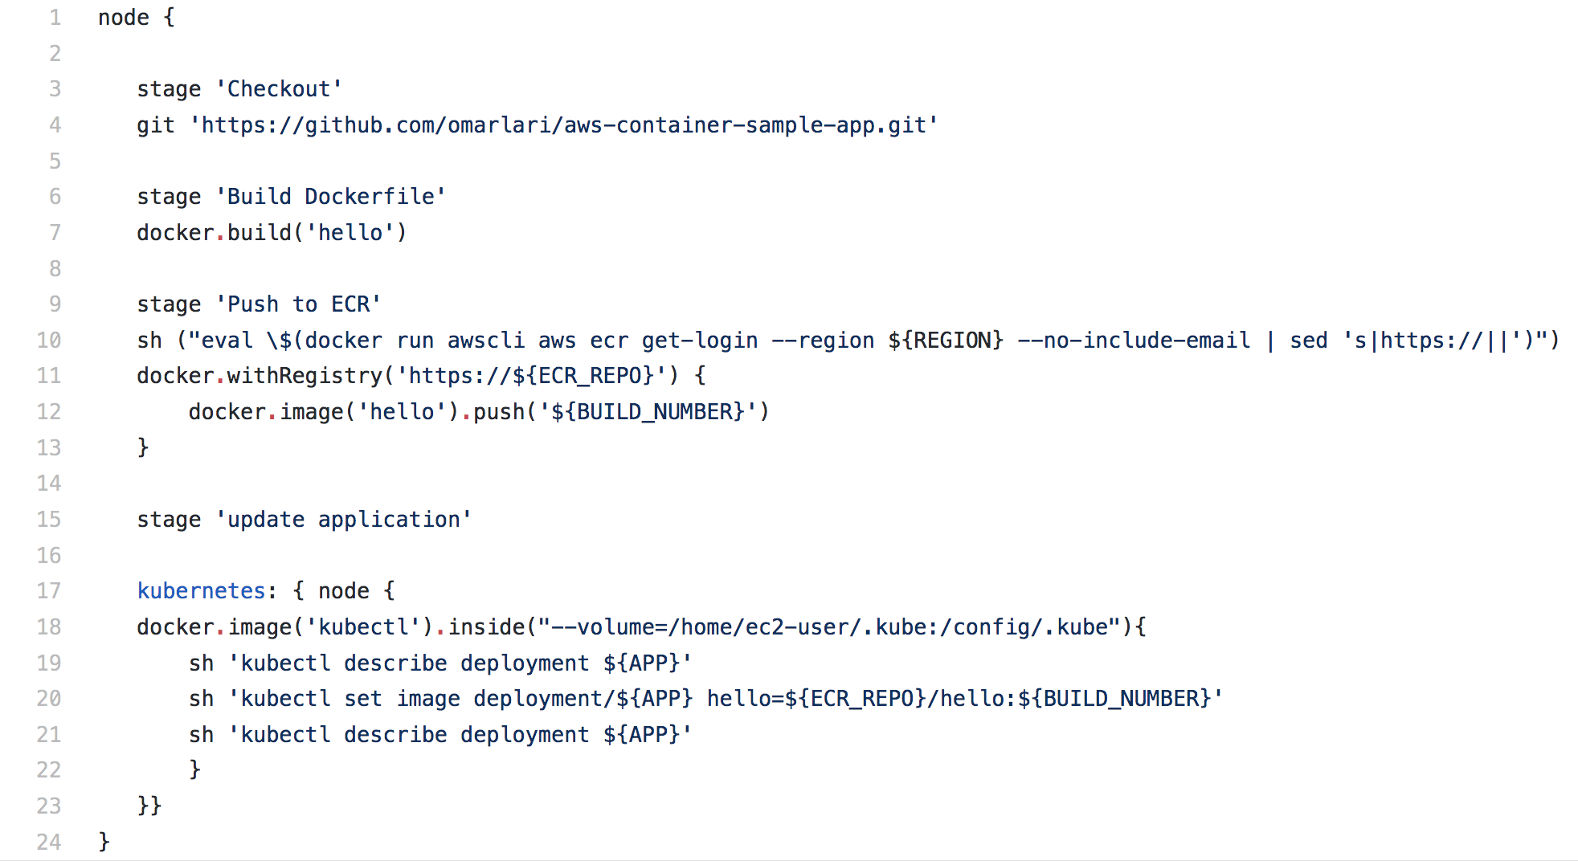
Jenkins
CI/CD with Kubernetes

Slide 22

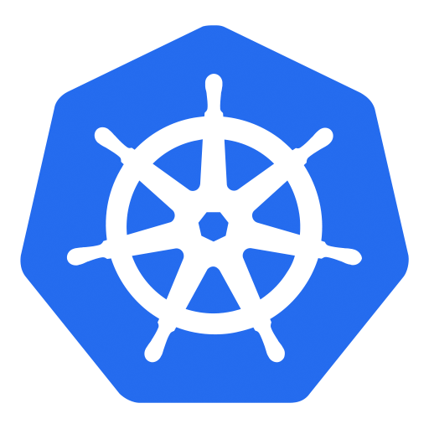
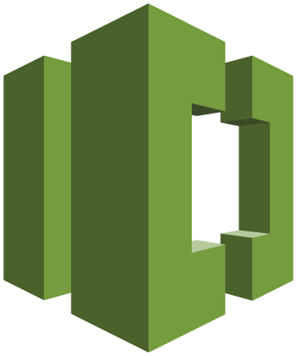

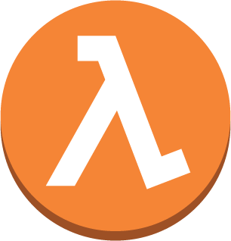

AWS CodePipeline
CI/CD with Kubernetes
6
1
Developers continuously integrate changes into a main branch hosted within a repo
Amazon ECR
2
Triggers an execution of the pipeline when a new version is found, builds a new image with build ID
3
5
3
Pushes the newly built image tagged with build ID to ECR repo
4
Invokes a Lambda function to trigger application deployment
1
2
4
5
Leverages Kubernetes Python SDK to update a deployment
Developer
AWS CodeCommit
AWS CodeBuild
AWS Lambda
6
Fetches new container image and performs a rolling update of deployment
AWS CodePipeline

Slide 23
CI/CD at Zalando with Kubernetes

Slide 24
CI/CD at Zalando with Kubernetes
200 engineering teams
Enforce CI/CD best practices
Teams responsible for CI/CD
“Hands off” operations
“Distributed” compliance
Compliance by design

Slide 25
First iteration
Jenkins
Challenge: map Jenkins to our requirements
Traceability: from production deploy to commit
Security: isolated VMs to build Docker images
One Jenkins for each Kubernetes cluster
Notes:
What would everybody would do? Try Jenkins! Didn’t really work for us…

Slide 26
First iteration
Jenkins
Easy to get started with, but…
Not truly “cloud native”:
Setup, upgrade
Credentials distribution (i.e., to push to the Docker registry)
Downtime during cluster updates (single replica StatefulSet)

Slide 27
Second iteration
Custom tool
Internal tool for builds and deployments
Faster build-time compared to our Jenkins
Built to support deployments to Kubernetes out of the box

Slide 28
Deployment model
Deployment configuration stored in a git repository
├── deploy/apply │ ├── deployment.yaml # K8s Deployment
│ ├── credentials.yaml # K8s CRD
│ ├── ingress.yaml # K8s Ingress
│ └── service.yaml # K8s Service
└── delivery.yaml # Configuration

Slide 29
3
AWS Identity and Access Management (IAM)

Slide 30
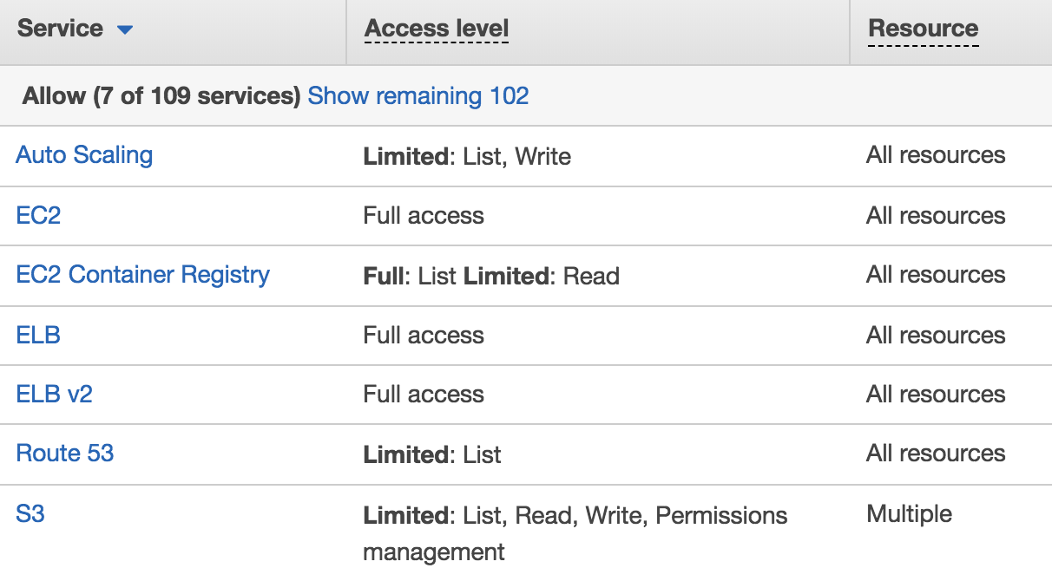
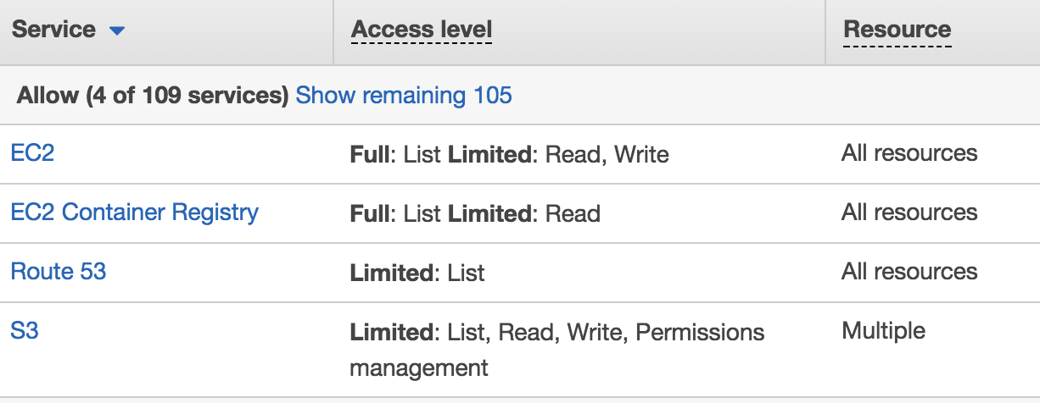
AWS Identity and Access Management
(IAM)
IAM enables secure access to AWS services and resources
Two IAM roles created for K8s cluster
Granular controls for Kubectl and Pods
Notes:
AWS Identity and Access Management (IAM) enables you to securely control access to AWS services and resources for your users. Using IAM, you can create and manage AWS users and groups, and use permissions to allow and deny their access to AWS resources.
Additional policies such as DynamoDB and Elasticsearch, can be granted to master or worker nodes for the cluster created using kops using “kops edit cluster”
Kops create profiles that are used by master
Node has to have AssumeRole
If you are in a secure environment, then use 3rd party credential system like: Vault that injects
Instance groups in Kops – can define different IAM roles and security groups
Default instance group, one IG per AZ
By default, IG for each master (for tagging and HA) – 3 node + 5 worker nodes will be 4 Igs
1 IG per AZ
IGs are Kops objects
Kops create cluster, kops edit instance-group, kops update cluster
Pre-create manifest and use that to create Kops cluster
Templating in 1.8, Golang templating
App level security – take it off k8s
Kube2iam, use IAM perms on the pod
Certain perms to IG, target pods to those group of nodes, use tags, labels, affinity
Why does Kops need so much IAM perms?
Kops creates the IAM profile
You can have somebody else create VPC
Tweaked the IAM roles significantly to be minimalist

Slide 31


IAM role for Kubectl
github.com/heptio/authenticator
Passes AWS Identity
1
Verifies AWS Identity
4
2
Kubectl
K8s action allowed/denied
K8s API
AWS Auth
3
Authorizes AWS Identity with RBAC
Notes:
A tool for using AWS IAM credentials to authenticate to a Kubernetes cluster.
When you create a kops cluster, then you use an IAM role with appropriate permissions required by kops. The cluster login information is generated in ~/.kube/config. If you want to manage k8s cluster from a different machine then you need AWS access key/secret key for the IAM role on that machine. “kops export kubecfg <name>” can be used to export the cluster configuration information. As a user, you need to maintain two set of credentials – one for AWS IAM and then another for kubectl authentication.
Because we’re hosting Kubernetes as a service, we need to provide authentication on the API endpoint with IAM. IAM isn’t currently supported as a built-in authentication mechanism, so let’s dig into how this works.

Slide 32

IAM role for Pods
EC2 Metadata Service
Pod 1
Pod 2
Pod 3
Notes:
The AWS Security Token Service (STS) is a web service that enables you to request temporary, limited-privilege credentials for AWS Identity and Access Management (IAM) users or for users that you authenticate (federated users).

Slide 33


IAM role for Pods
Kube2iam: github.com/jtblin/kube2iam
EC2 Metadata Service
Kube2iam DaemonSet
3
2
Pod 1
1
Retrieve temporary credentials
Pod 2
Pod 3
Security Token Service
Notes:
The AWS Security Token Service (STS) is a web service that enables you to request temporary, limited-privilege credentials for AWS Identity and Access Management (IAM) users or for users that you authenticate (federated users).

Slide 34
IAM role for Pods
Kube2iam
kind: Deployment spec:
template:
metadata:
annotations:
# annotation for kube2iam iam.amazonaws.com/role: "myapp-role" spec: containers: - name: ... ...

Slide 35
IAM roles for Pods
Hashicorp Vault
Secures, stores and controls access to tokens, passwords, certificates Generate IAM credentials
Secure Protection Identity Framework for Everyone (SPIFFE)
Securely passing secrets like IAM roles to pod/container Standard that applies to container runtimes, in general Enhance other CNCF projects
Notes:
Hashicorp Vault is a tool for managing secrets. It secures, stores and tightly controls access to tokens, passwords, certificates, API keys and other secrets.
Can generate temporary IAM credentials based upon configured policies.
First, from a cloud provider perspective, a standard for pod/container identity eases the burden of securely passing secrets like IAM roles or credentials to workloads. We suspect there are other use cases here as well, like correlating AWS level metadata like tags, and granularly configuring security controls like VPC Security Groups.
More broadly speaking, we are excited about the potential for SPIFFE to provide a standard that applies to container runtimes in general, whether that is Docker, CRI-Containerd, or whatever the future will bring.
Finally, we sense the opportunity for this project to enhance other CNCF projects, especially in the service discovery and service mesh space. If Istio/Envoy/Linkerd can offload fingerprinting of workloads to SPIFFE, these projects can focus on their core competencies and not worry about underlying secure introduction problem.

Slide 36
IAM at Zalando

Slide 37
AWS IAM
Using Kube2IAM (DaemonSet) to assign IAM roles to pods
Four-eyes principle for deployments
Developers can choose the IAM role

Slide 38
“Platform” IAM
Users and services
Internal IAM infrastructure
Every microservice is OAuth protected
Authentication and authorization is based on a custom WebHook
Authn, Authz
Kubernetes native integration
Slowly transitioning to RBAC

Slide 39
2
Credential Provider
OAuth Provider
Reads CRD
3
Writes Secret
Credential provider
API Server
1
Creates CRD
Worker Node
Kubelet
Pod
../my_secret_token

Slide 40
4
Visibility in cluster

Slide 41
Visibility about your Kubernetes cluster
Logs
Metrics
Events
Alerts
Tracing
Cluster
Node
Container
Application

Slide 42


Region
Logs
AZ1
ASG
ASG
Amazon CloudWatch Logs
Master
Worker
Worker
Fluentd DaemonSet
Kubectl logs
Amazon Elasticsearch
Service
AZ2
Master
Worker
Worker
Elasticsearch (index), Fluentd (store), and Kibana (visualize)
Kibana
Notes:
Kubectl logs -> pods dump logs to disk, kubectl logs calls the API server, pulling Docker logs off the disk
Instead install DaemonSet
In terms of architecture, Fluentd is deployed as a DaemonSet with the CloudWatch Logs plugin. The default configuration will stream system logs, Kubernetes container logs, Docker logs and Kubernetes API server audit logs to a CloudWatch log group. An AWS Lambda function, which is provided for you, will stream the Log Group into an Amazon Elasticsearch cluster. The logs can then be viewed using a Kibana dashboard.
Fluentd DaemonSet could also directly write to Kibana.
Logs can also be sent to a Kafka stream for further real-time processing.

Slide 43
Visualizer
Grafana, Kibana, Dashboard
Alerting
AlertManager, Kapacitor
Cluster-wide Aggregator
Prometheus, Heapster
Metrics
Nodes
Node exporter
Pod/Container
Kube-state-metrics
cAdvisor
Application
/metrics
JMX
Data Model
InfluxDB, Graphite
Notes:
Tune the Docker logs in different manner
System logs
Docker logs
Pod has a PID
PID writes to STDOUT
Docker picks it up and dumps to file
Debian: daemon.log
System log (systemd logs): Kernel panics, messages from Docker, kubelet, API server
Why my pod is not scheduling? - Kubectl events, kubectl describe will help
Basic is throw Prometheus – aggregator for events, not a long term persistent store

Slide 44

Application tracing with Kubernetes
Analyze and debug production, distributed applications, such as those built using a microservices architecture
Identify and troubleshoot the root cause of performance issues and errors
End-to-end view of requests as they travel through your application

Slide 45
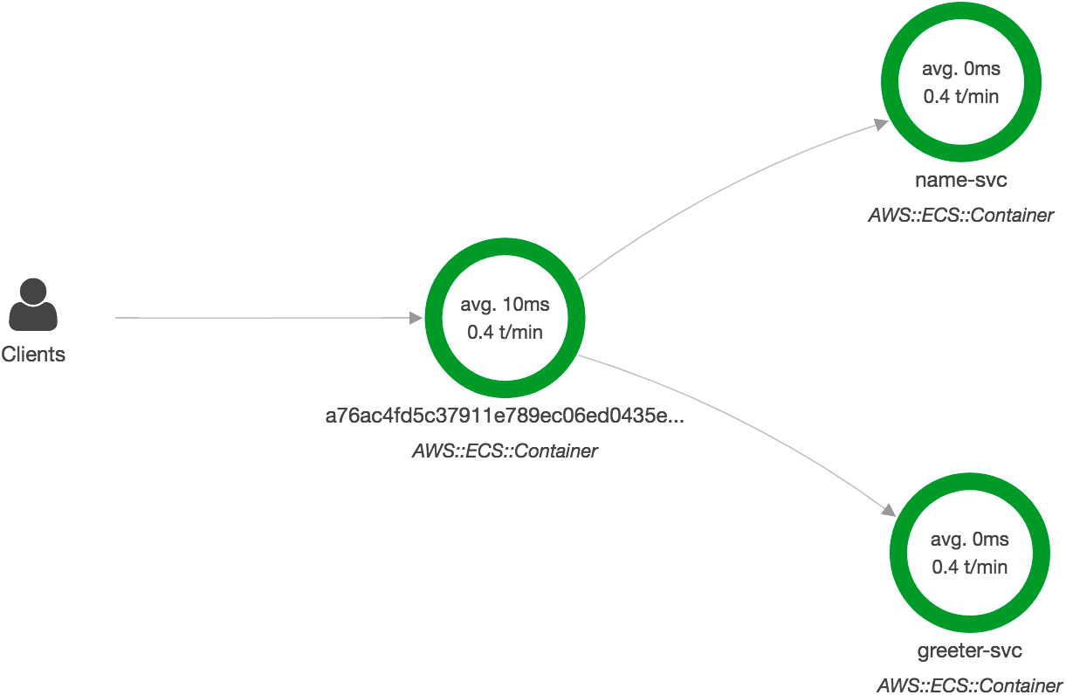

Slide 46
Visibility in cluster at Zalando

Slide 47
Logging with Kubernetes
Centralized logging solution: Scalyr
Applications just log to STDOUT
A DaemonSet streams logs to a centralized account

Slide 48
Monitoring setup
Existing monitoring/alerting tool: ZMON
Prometheus node exporter as DaemonSet to get system metrics
Heapster to collect pods metrics

Slide 49
Application monitoring
Alerts and metrics
Default checks/alerts for the deployed applications
Metrics available in standard format from our Ingress Controller
Latency, error rate
Useful for Service Level Reporting

Slide 50
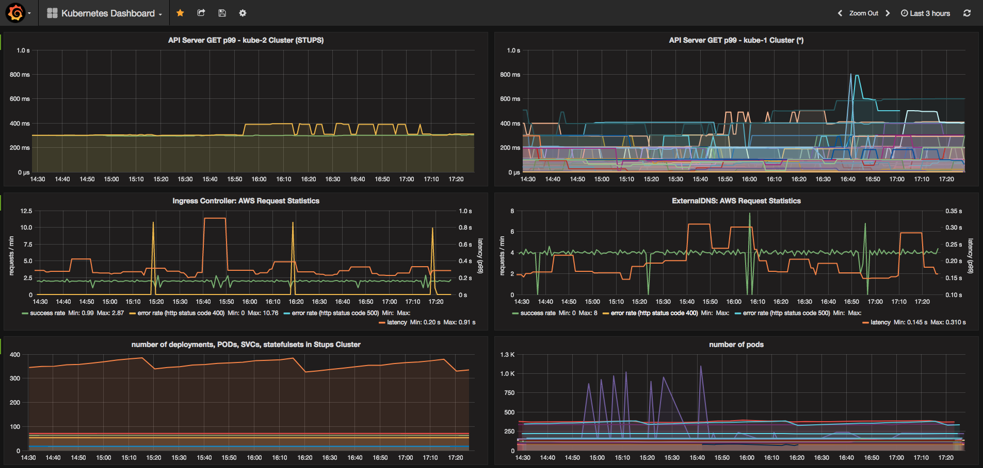
Visualizer
Cluster dashboard

Slide 51
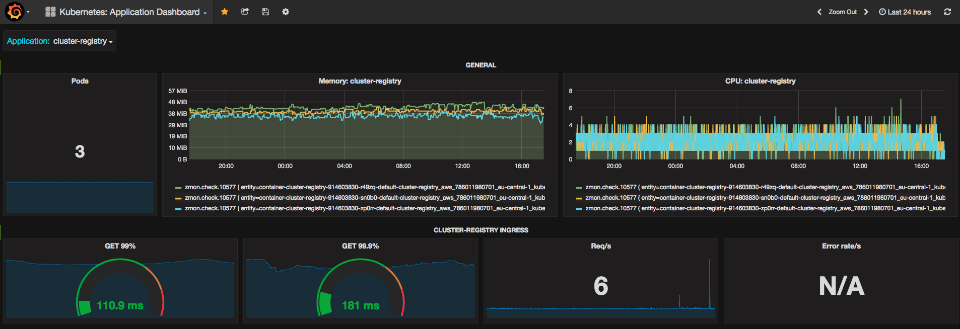
Visualizer
Application dashboard

Slide 52
Closing remarks
More factors to consider
Configuring sane defaults (for example, LimitRange)
Knowing and understanding cluster limits
Simplifying user experience (for example, Ingress, ExternalDNS)
Notes:
Feel free to adjust all this to your org, here some more things that you can use. I’ll be happy to talk with you after the talk if you have questions.

Slide 53
References
github.com/aws-samples/aws-workshop-for-kubernetes

